Slide 1
International Herbicide-Resistant Weeds Database
HRAC codes
Graphs in this PowerPoint were made from data accessed from the survey website at http://www.weedscience.org on July, 2021.
Ian Heap – IanHeap@weedscience.org

Slide 2
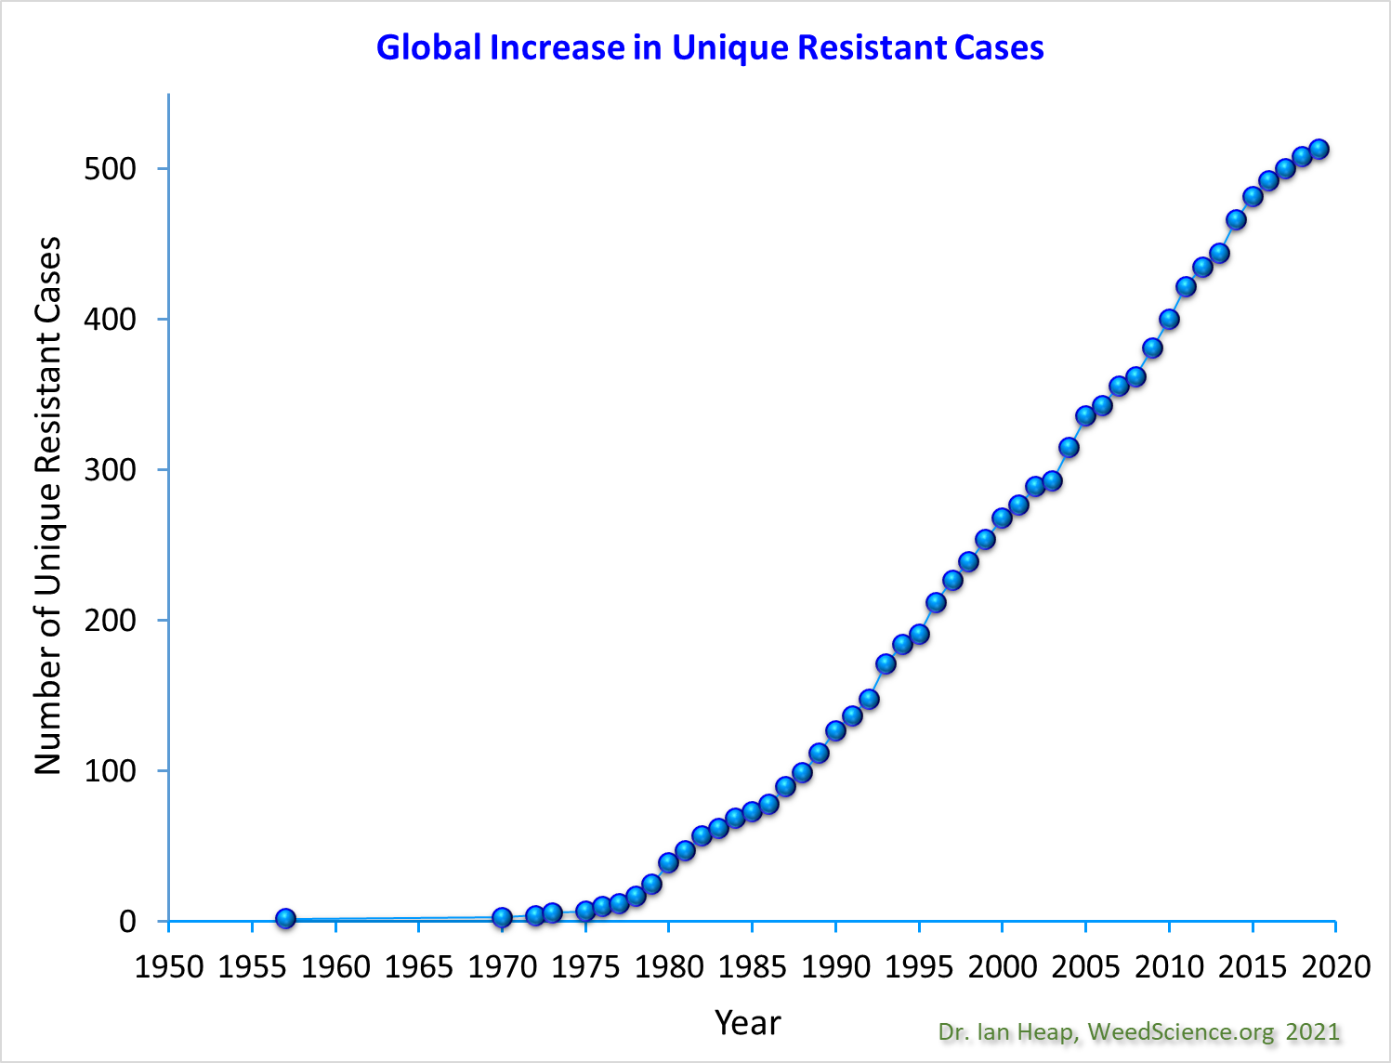
Notes:
This graph presents the chronological increase in unique cases of herbicide resistant weeds. A unique case is a SPECIES x SITE of ACTION. So if a Conyza canadensis becomes resistant to atrazine (Group C1) it is listed as one unique case, if another population of Conyza canadensis becomes resistant to ALS inhibitors (Group B), then it is counted as a separate “Unique” case, but if a third population is found with multiple resistance to ALS and Triazine herbicides it does not count, as the other two already cover the sites of action.

Slide 3
Notes:
This graph presents the chronological increase in resistance to 5 herbicide sites of action. The letters refer to the Weed Science Society of America code (WSSA) to identify herbicide sites of action. Different herbicide sites of action have different propensities to select resistance. PSII inhibitor (Group 5, 6, 7) herbicides, primarily atrazine resistant weeds in corn, dominated in the USA and Europe in the 1970’s and 80’s. ALS inhibitor (Group 2) herbicides are the most prone to resistance. Note that the Y axis is the number of species (because a species is only plotted once per site of action).

Slide 4
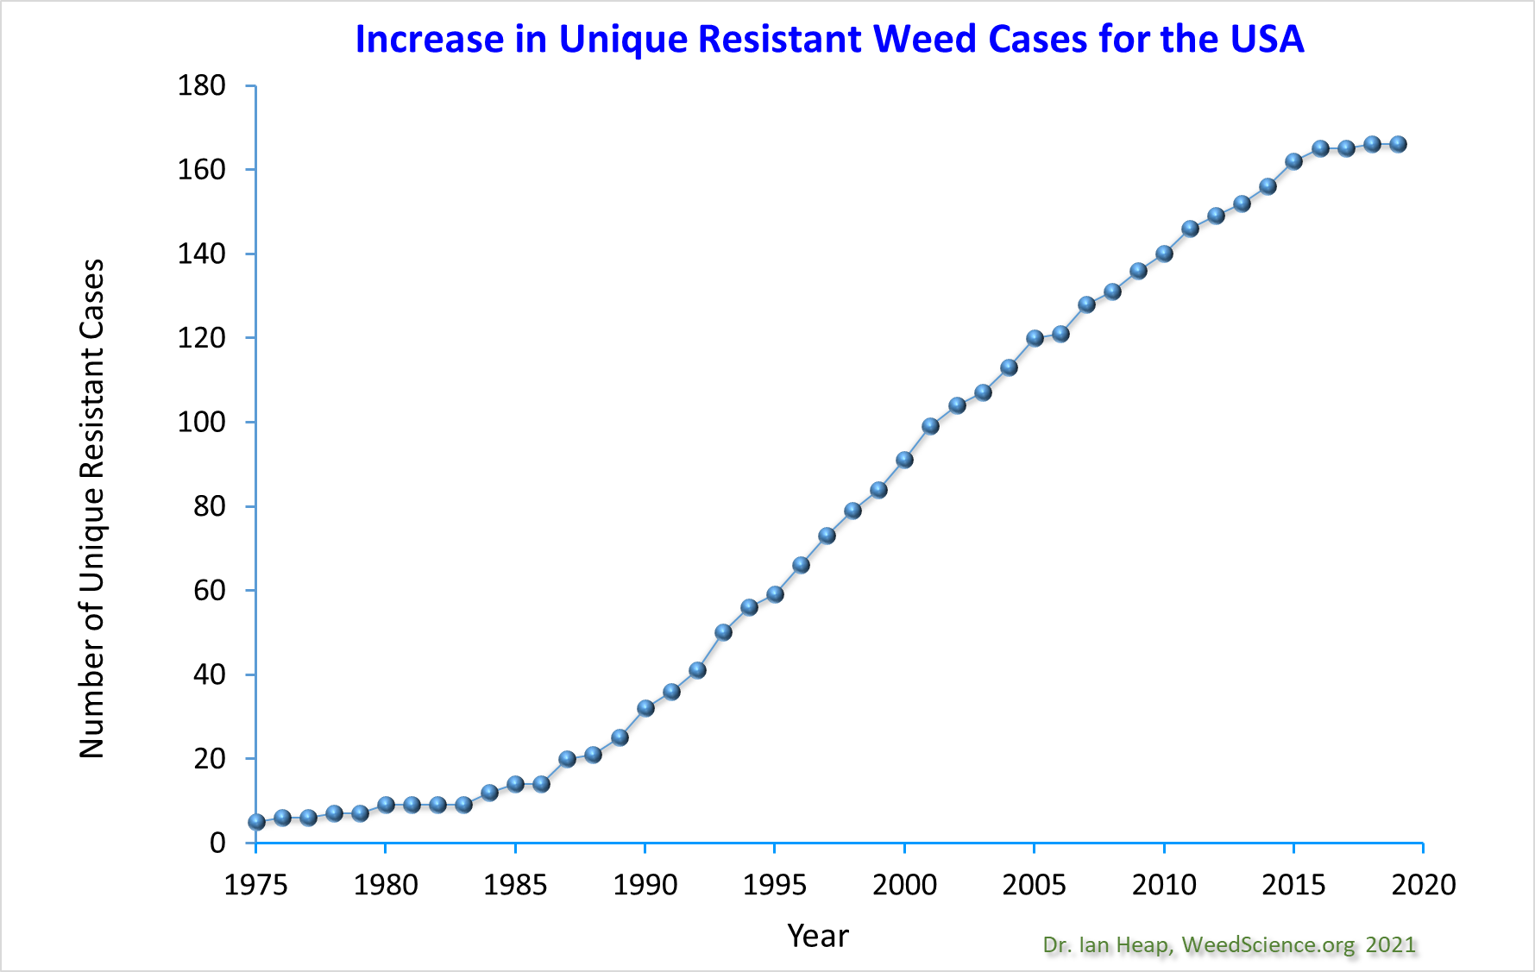

Slide 5
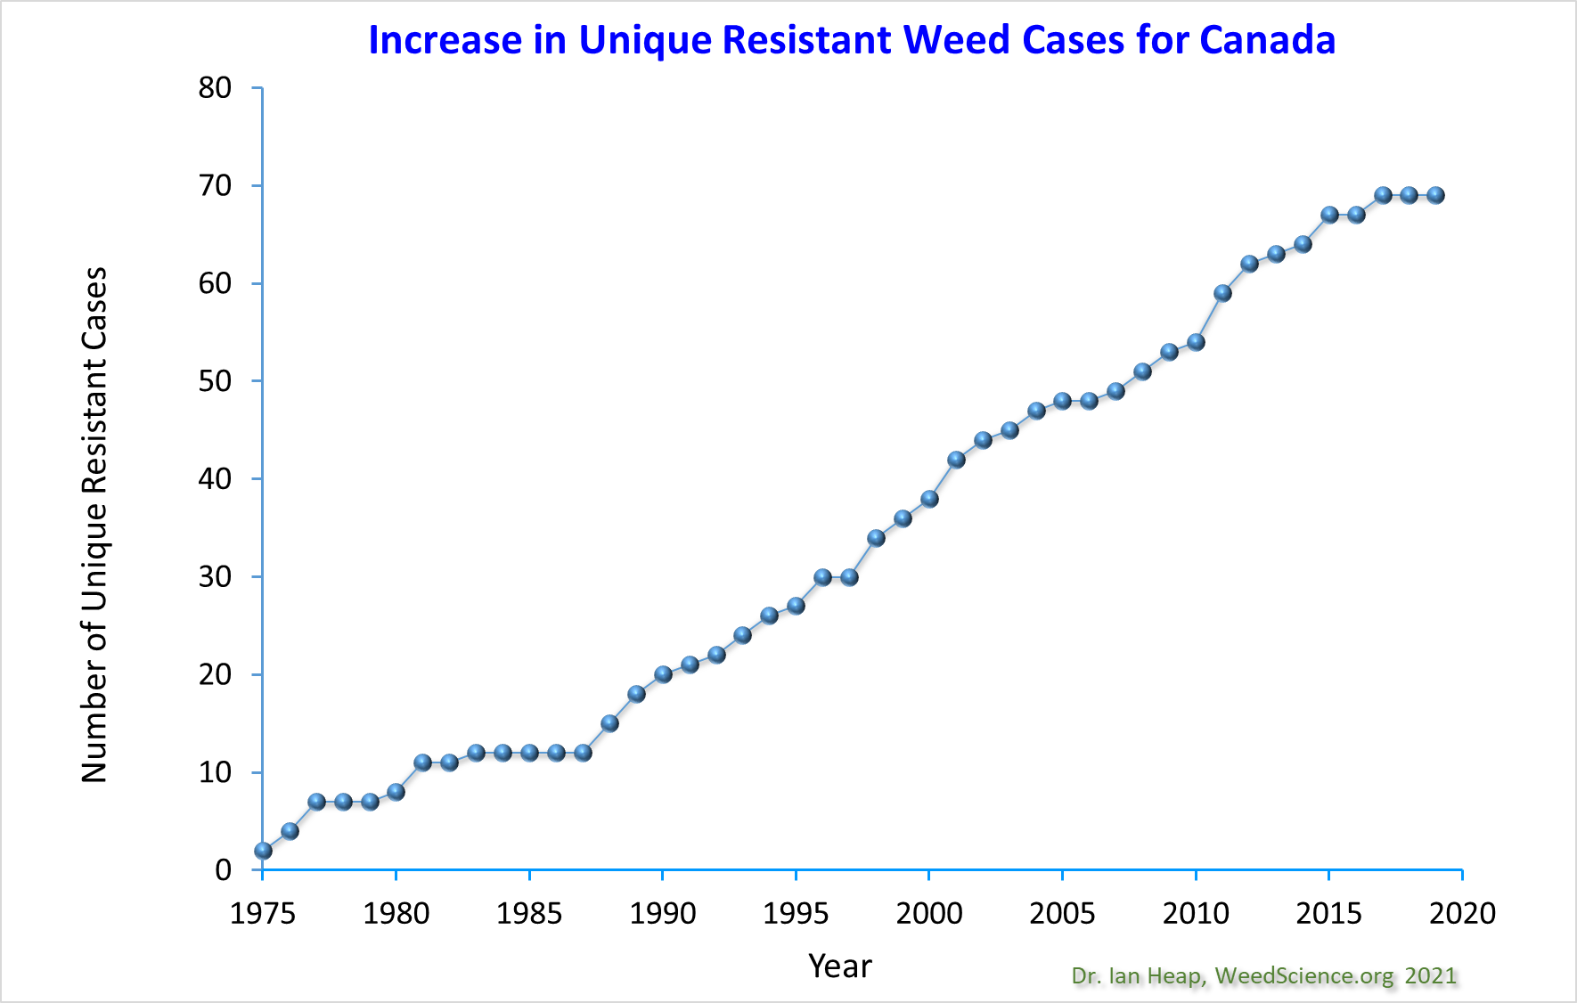

Slide 6
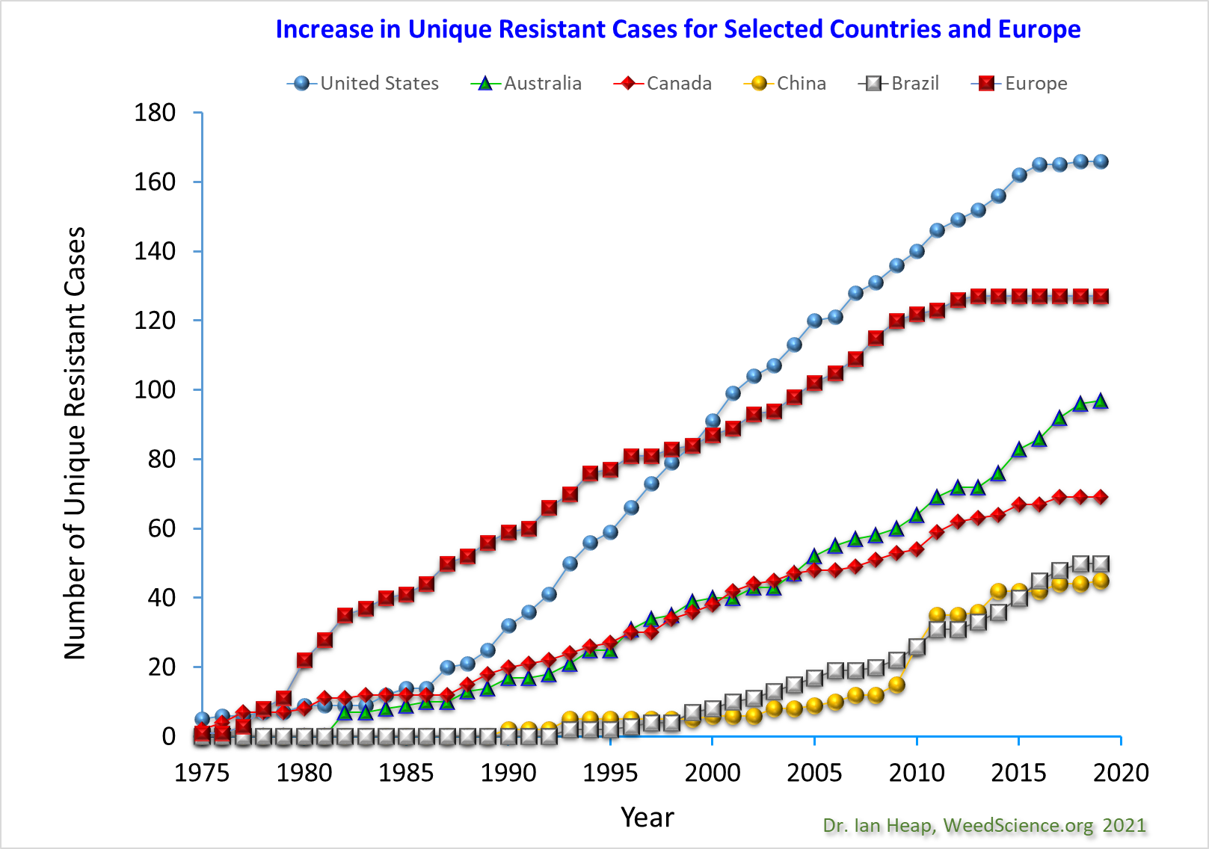

Slide 7
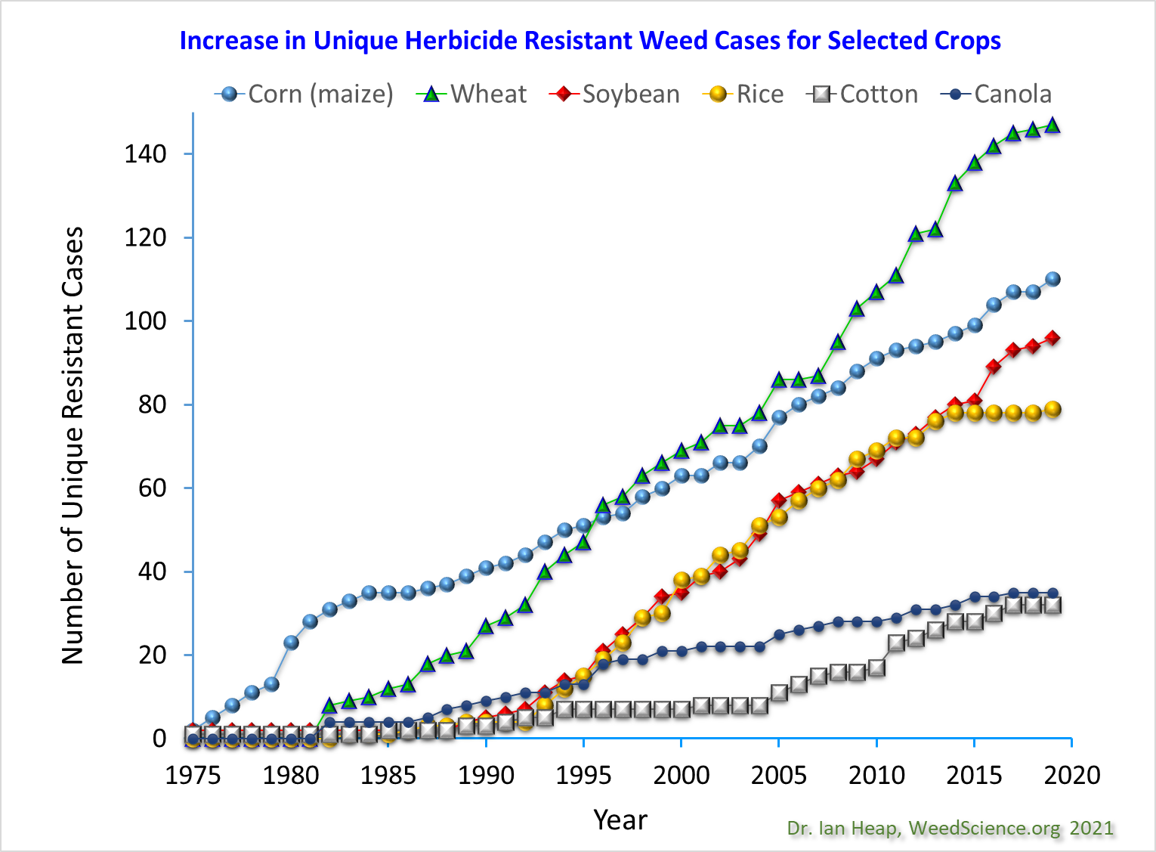

Slide 8
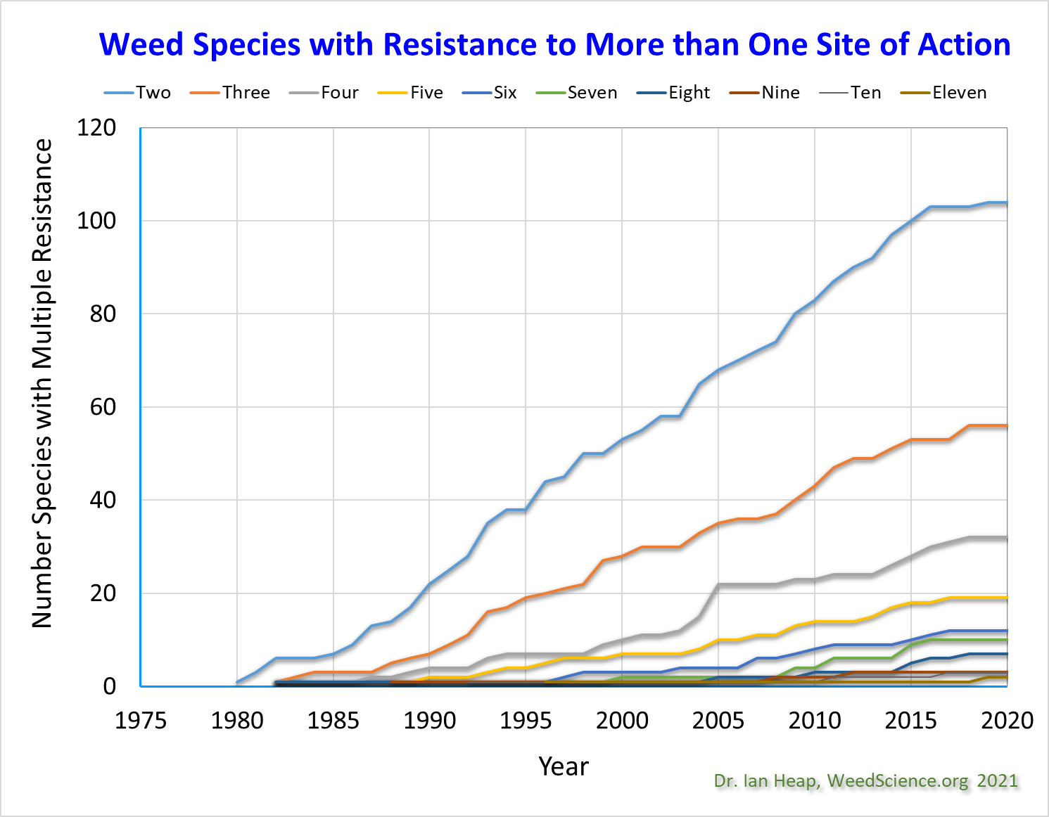

Slide 9
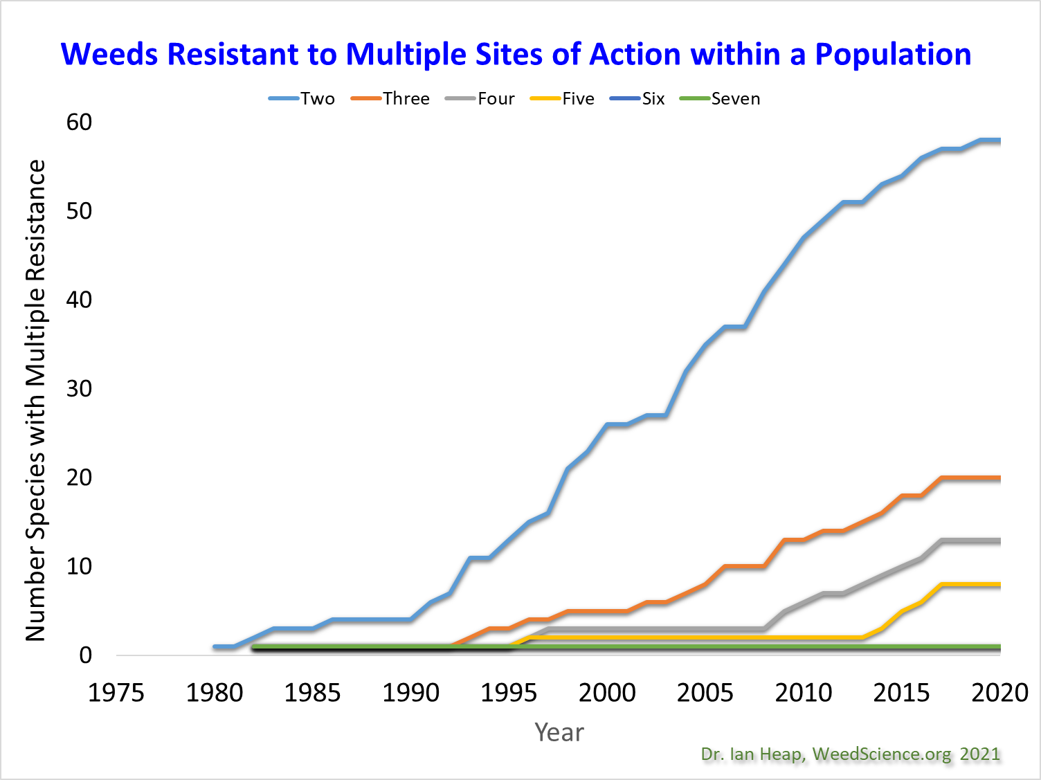

Slide 10
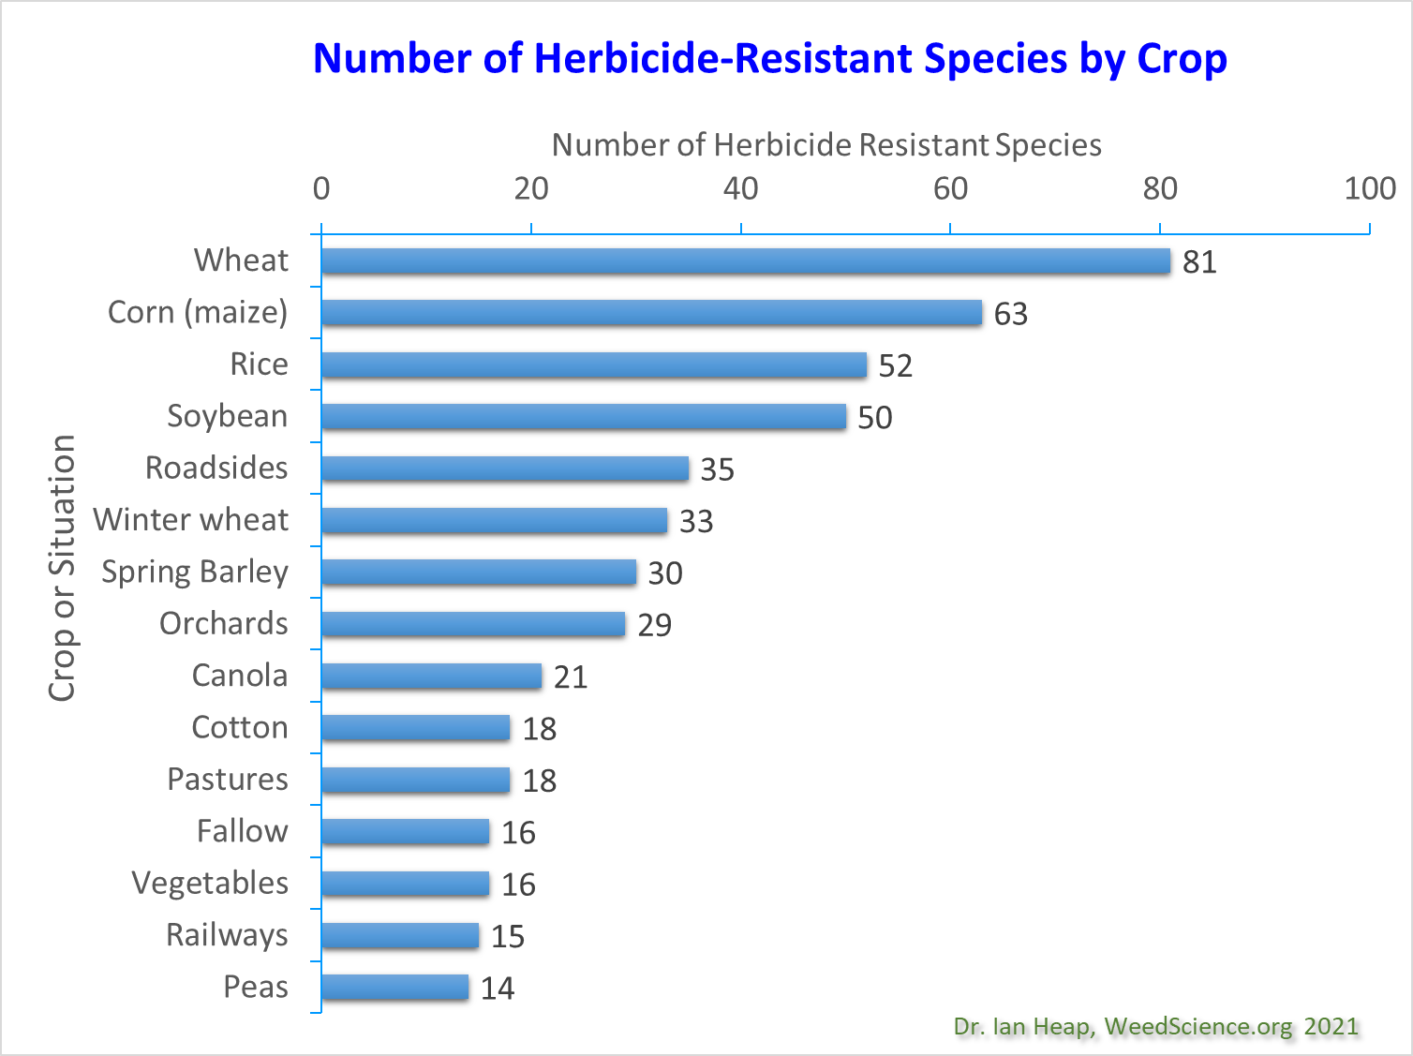

Slide 11
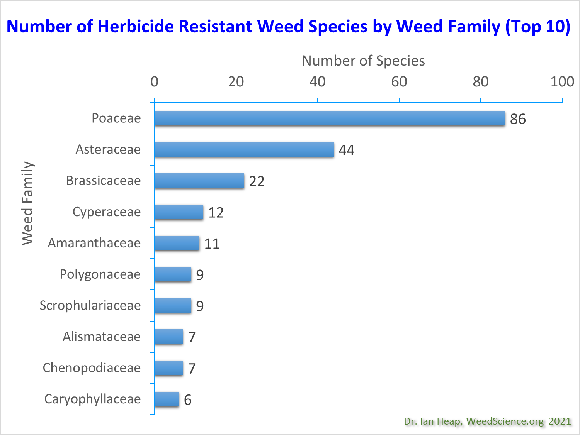

Slide 12
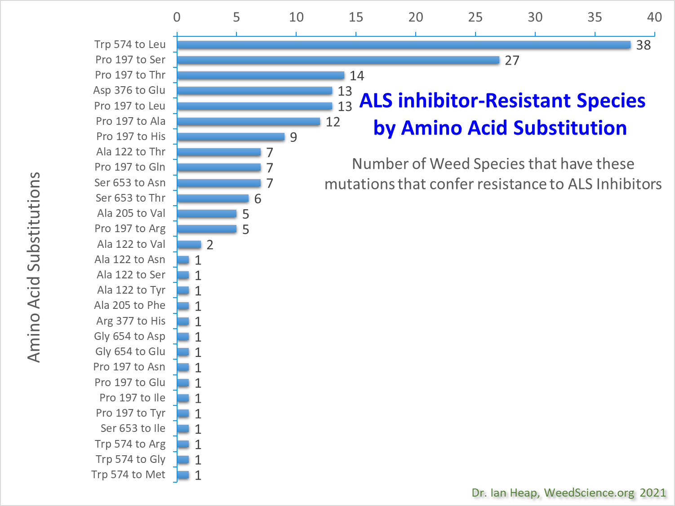

Slide 14
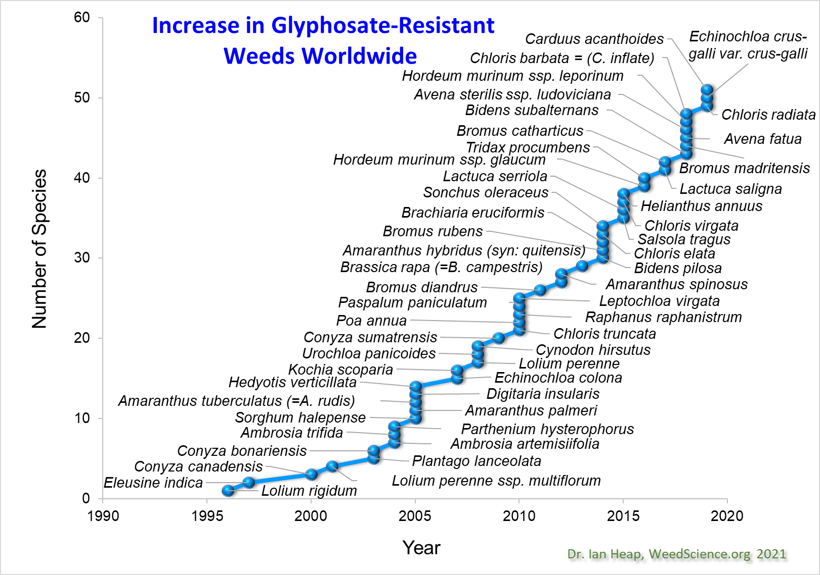

Slide 15
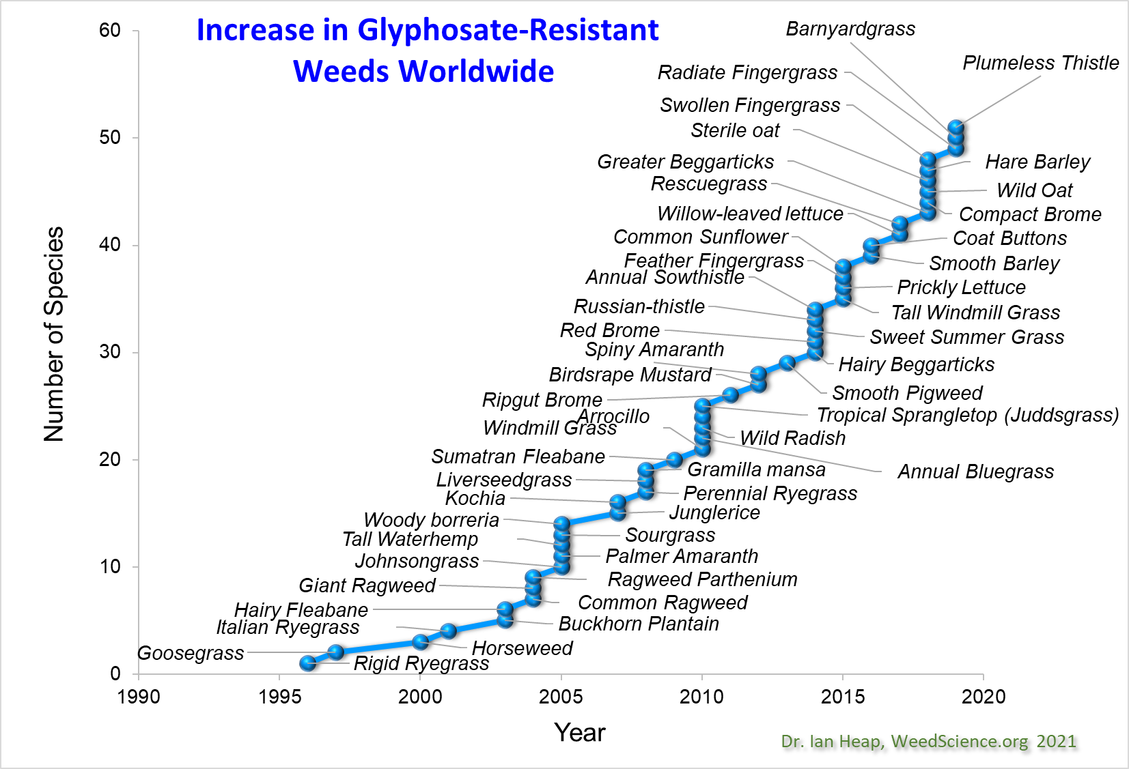

Slide 16
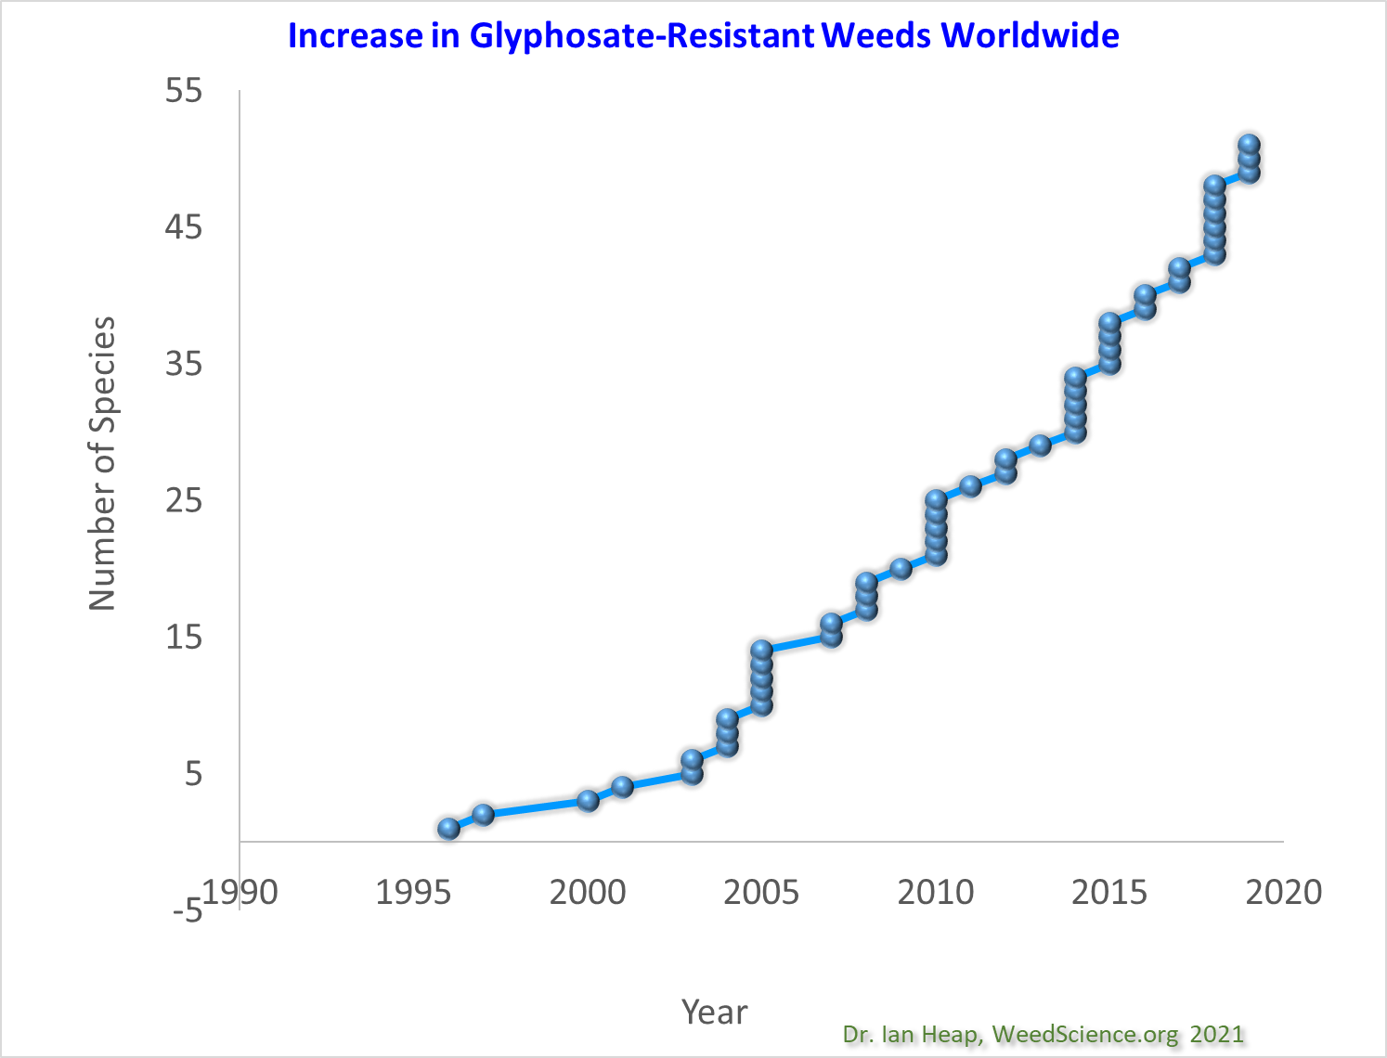

Slide 18
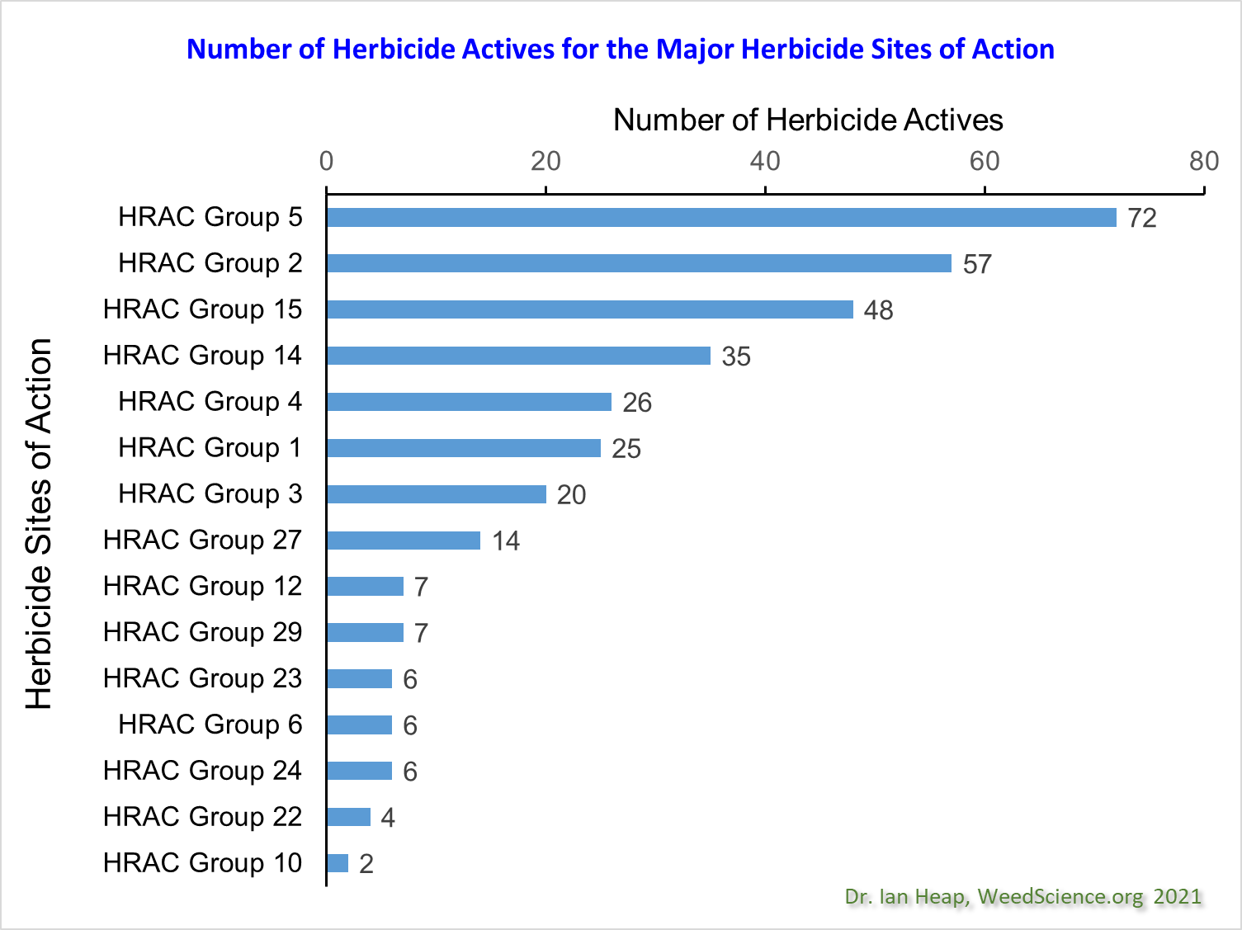

Slide 20


